Slide 1
7COM1025 Programming for Software Engineers
7COM1025 Programming for Software Engineers
Design Pattern (3)
Dr Hui Cheng
Email: h.cheng2@herts.ac.uk

Slide 2
Design Pattern (3)

Slide 3
Factory: it's easy to think of factories in the real world - a factory is just somewhere that items gets produced such as cars, computers or TVs.
The Factory Pattern
provides a simple decision making class that returns one of several possible subclasses of a base class depending on the data that are provided;
allows the sub-classes to choose the type of objects to create;
does not expose creation logic to the client and refer the created object using a standard interface;
also known as Virtual Constructor.
It is the most used design pattern in Java.

Slide 4
Abstract Factory Pattern
The Abstract Factory Pattern
The Abstract Factory pattern works around a super-factory which creates other factories. This factory is also called as factory of factories.
The Abstract Factory Pattern provides an interface for creating a factory of related objects without explicitly identifying their classes. That means Abstract Factory allows a class to return a factory of classes.
Each generated factory can give the objects according to the Factory pattern..
Both design patterns belong to the Creational Pattern as this pattern provides one of the best ways to create an object.

Slide 5
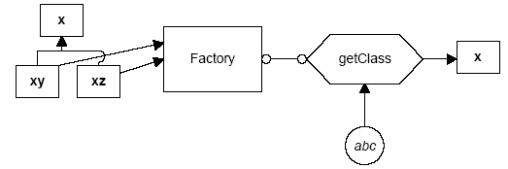
The Factory pattern returns an instance of one of several possible classes depending on the data provided to it.
Here, x is a base class and classes xy and xz are derived from it.
The Factory is a class that decides which of these subclasses to return depending on the arguments you give it.
The getClass() method passes in some value abc, and returns some instance of the class x. Which one it returns doesn't matter to the programmer since they all have the same methods, but different implementations.

Slide 6
The Base Class
Let's consider a simple case where we could use a Factory class. Suppose we have an entry form and we want to allow the user to enter his name either as “firstname lastname” or as “lastname, firstname”.
Let’s make the assumption that we will always be able to decide the name order by whether there is a comma between the last and first name.
class Namer { //a class to take a string apart into two names
protected String last; //store last name here
protected String first; //store first name here
public String getFirst() {
return first; //return first name
}
public String getLast() {
return last; //return last name
}
}

Slide 7
The First Derived Class
In the FirstFirst class, we assume that everything before the last space is part of the first name.
class FirstFirst extends Namer {
public FirstFirst(String s) {
int i = s.lastIndexOf(" "); //find separating space
if (i > 0) {
first = s.substring(0, i).trim(); //left = first name
last =s.substring(i+1).trim(); //right = last name
} else {
first = “” // put all in last name
last = s; // if no space
}
}
}

Slide 8
The Second Derived Class
In the LastFirst class, we assume that a comma delimits the last name.
class LastFirst extends Namer { //split last, first
public LastFirst(String s) {
int i = s.indexOf(","); //find comma
if (i > 0) {
last = s.substring(0, i).trim(); //left= last name
first = s.substring(i + 1).trim(); //right= first name
} else {
last = s; // put all in last name
first = ""; // if no comma
}
}
}

Slide 9
Building the Factory
The Factory class is relatively simple. We just test for the existence of a comma and then return an instance of one class or the other.
class NameFactory {
//returns an instance of LastFirst or FirstFirst
//depending on whether a comma is found
public Namer getNamer(String entry) {
int i = entry.indexOf(","); //comma determines name order
if (i>0)
return new LastFirst(entry); //return one class
else
return new FirstFirst(entry); //or the other
}
}

Slide 10
Using the Factory
NameFactory nfactory = new NameFactory();
String sFirstName, sLastName;
….
private void computeName() {
//send the text to the factory and get a class back
namer = nfactory.getNamer(entryField.getText());
//compute the first and last names using the returned class
sFirstName = namer.getFirst();
sLastName = namer.getLast();
}

Slide 11
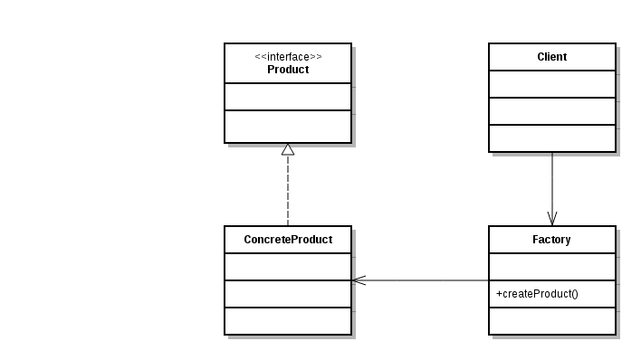
UML Diagram

Slide 12
When to use the Factory Pattern
You should consider using a Factory pattern when:
A class can’t anticipate which kind of class of objects it must create.
A class uses its subclasses to specify which objects it creates.
You want to localise the knowledge of which class gets created.

Slide 13
The Abstract Factory Pattern
The Abstract Factory pattern is one level of abstraction higher than the factory pattern.
This pattern returns one of several related classes, each of which can return several different objects on request.
In other words, the Abstract Factory is a factory object that returns one of several factories.

Slide 14
A Garden Maker Factory
Suppose you are writing a program to plan the layout of gardens. These could be annual gardens, vegetable gardens or perennial gardens. However, no matter which kind of garden you are planning, you want to ask the same questions:
What are good border plants?
What are good center plants?
What plants do well in partial shade?
We want a base Garden class that can answer these questions:
public abstract class Garden {
public abstract Plant getCenter();
public abstract Plant getBorder();
public abstract Plant getShade();
}

Slide 15
The Plant Class
The Plant class simply contains and returns the plant name:
public class Plant {
String name;
public Plant(String pname) {
name = pname; //save name
}
public String getName() {
return name;
}
}

Slide 16
A Garden Class
A Garden class simply returns one kind of each plant. So, for example, for the vegetable garden we simply write:
public class VegieGarden extends Garden {
public Plant getShade() {
return new Plant("Broccoli");
}
public Plant getCenter() {
return new Plant("Corn");
}
public Plant getBorder() {
return new Plant("Peas");
}
}

Slide 17
A Garden Maker Class – The Abstract Factory
We create a series of Garden classes - VegieGarden, PerennialGarden, and AnnualGarden, each of which returns one of several Plant objects. Next, we construct our abstract factory to return an object instantiated from one of these Garden classes and based on the string it is given as an argument:
class GardenMaker {
//Abstract Factory which returns one of three gardens (factories)
private Garden gd;
public Garden getGarden(String gtype) {
gd = new VegieGarden(); //default
if(gtype.equals("Perennial"))
gd = new PerennialGarden();
if(gtype.equals("Annual"))
gd = new AnnualGarden();
return gd;
}
}

Slide 18
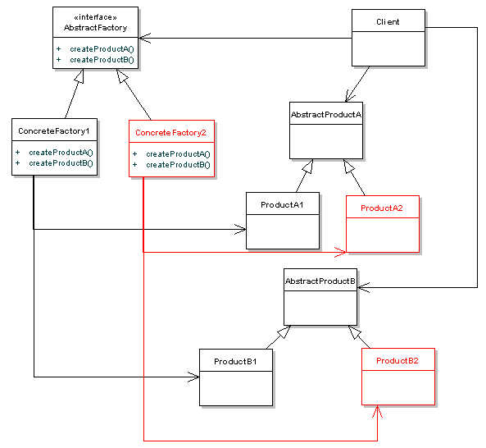
UML Diagram

Slide 19
Each factory will create one of each of these AbstractProducts.
The Client deals with AbstractFactory, AbstractProductA and AbstractProductB.
The Client doesn't know anything about the implementations. The actual implementation of AbstractFactory that the Client uses is determined at runtime.
The client is totally decoupled from the concrete products.
Also, new product families can be easily added into the system, by just adding in a new type of ConcreteFactory that implements AbstractFactory, and creating the specific Product implementations.

Slide 20
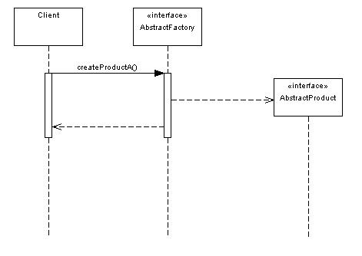
Sequence Diagram from Client
The client has no need to worry about what implementations are lying behind
the interfaces, protecting them from change further down the line.

Slide 21
UI Toolkit Example
An example of an Abstract Factory in use could be UI toolkits. Across Windows, Mac and Linux, UI composites such as windows, buttons and textfields are all provided in a widget API like SWT.
However, the implementation of these widgets vary across platforms. You could write a platform independent client thanks to the Abstract Factory implementation.
//Our AbstractProduct
public interface Window{
public void setTitle(String text);
public void repaint();
}

Slide 22
Concrete Products
//ConcreteProductA1
public class MSWindow implements Window{
public void setTitle(){
//MS Windows specific behaviour
}
public void repaint(){
//MS Windows specific behaviour
}
}
//ConcreteProductA2
public class MacOSXWindow implements Window{
public void setTitle(){
//Mac OSX specific behaviour
}
public void repaint(){
//Mac OSX specific behaviour
}
}

Slide 23
Abstract Factory and Concrete Ones
//AbstractFactory
public interface AbstractWidgetFactory{
public Window createWindow();
}
//ConcreteFactory1
public class MsWindowsWidgetFactory{
//create an MSWindow
public Window createWindow(){
MSWindow window = new MSWindow();
return window;
}
}
//ConcreteFactory2
public class MacOSXWidgetFactory{
//create a MacOSXWindow
public Window createWindow(){
MacOSXWindow window = new MacOSXWindow();
return window;
}
}

Slide 24
Finally, Client
//Client
public class GUIBuilder{
public void buildWindow(AbstractWidgetFactory widgetFactory){
Window window = widgetFactory.createWindow();
window.setTitle("New Window");
}
}

Slide 25
Of course, we need some way to specify which type of AbstractWidgetFactory to our GUIBuilder. This is usually done with a switch statement similar to the code below:
public class Main{
public static void main(String[] args){
GUIBuilder builder = new GUIBuilder();
AbstractWidgetFactory widgetFactory = null;
//check what platform we're on
if(Platform.currentPlatform()=="MACOSX"){
widgetFactory = new MacOSXWidgetFactory();
} else {
widgetFactory = new MsWindowsWidgetFactory();
}
builder.buildWindow(widgetFactory);
}
}

Slide 26
Consequences of Abstract Factory
+One of the main purposes of the Abstract Factory is that it isolates the concrete classes that are generated.
+The actual class names of these classes are hidden in the factory and need not be known at the client level at all.
+Because of the isolation of classes, you can change or interchange these product class families freely.
-With both the Factory pattern and the Abstract Factory pattern, someone has to determine what type of factory the client is dealing with at runtime. This is usually done with some type of switch statement.

Slide 27
In summary
Factory Pattern
provides a simple decision making class that returns one of several possible subclasses of a base class depending on the data that are provided;
allows the sub-classes to choose the type of objects to create;
does not expose creation logic to the client and refer the created object using a standard interface;
also known as Virtual Constructor;
the most used design pattern in Java.
Abstract Factory Pattern
The Abstract Factory pattern works around a super-factory which creates other factories. This factory is also called as factory of factories.
The Abstract Factory Pattern provides an interface for creating a factory of related objects without explicitly identifying their classes. That means Abstract Factory allows a class to return a factory of classes.
Each generated factory can give the objects according to the Factory pattern.

Slide 28
The differences between factory and abstract factory design pattern
Factory design pattern produces implementation of Products, e.g. Garment Factory produce different kinds of clothes.
On the other hand, Abstract Factory design pattern adds another layer of abstraction over Factory Pattern and Abstract Factory implementation itself. For example, Abstract Factory will allow you to choose a particular Factory implementation based upon need which will then produce different kinds of products.
In short:
1) Abstract Factory design pattern creates Factory
2) Factory design pattern creates Products

